Slide 1
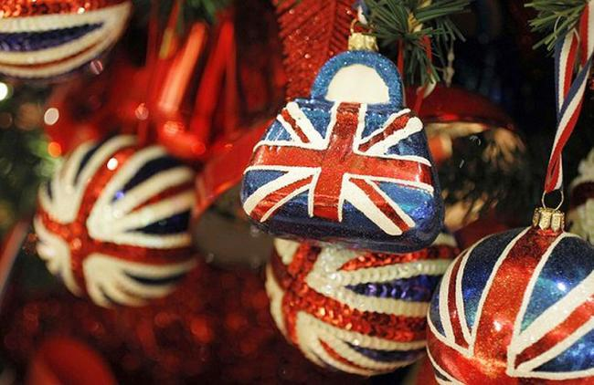
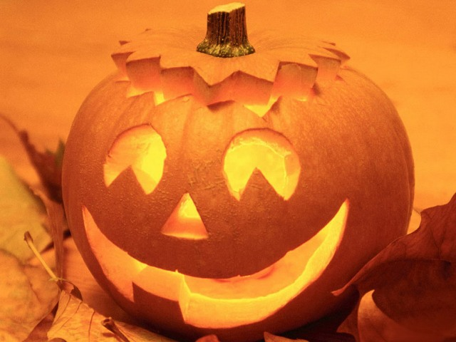
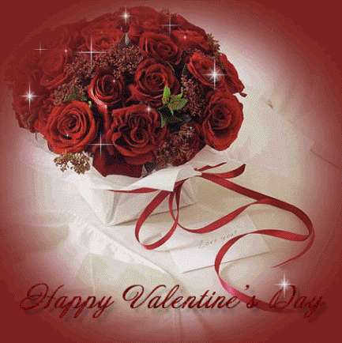
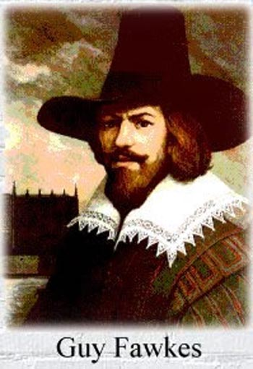
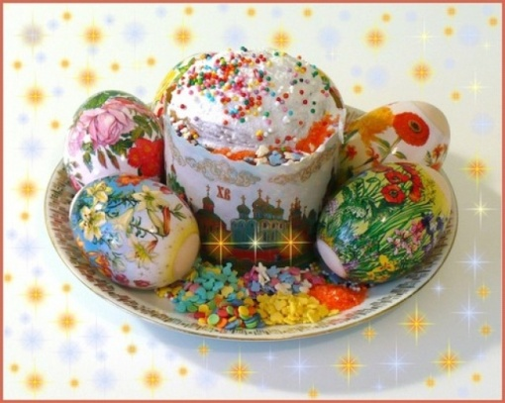
Traditions and celebrations in Britain .
Презентацию выполнила : учитель английского языка Манюк А.Н ГБОУСОШ № 223
Prezented.Ru

Slide 2
What things come to your mind when you think
of traditions and celebrations?
Things we give and receive
Activities
Traditions
Celebrations
Special occasions
Special food
and drinks
wedding, cards, anniversary, tricks, birthday, firework, champagne, cake, parade, picnic, dancing, flowers

Slide 3
British celebrations
St Valentine’s Day
Christmas
Easter
Halloween
New Year
Guy Fawkes Night

Slide 4
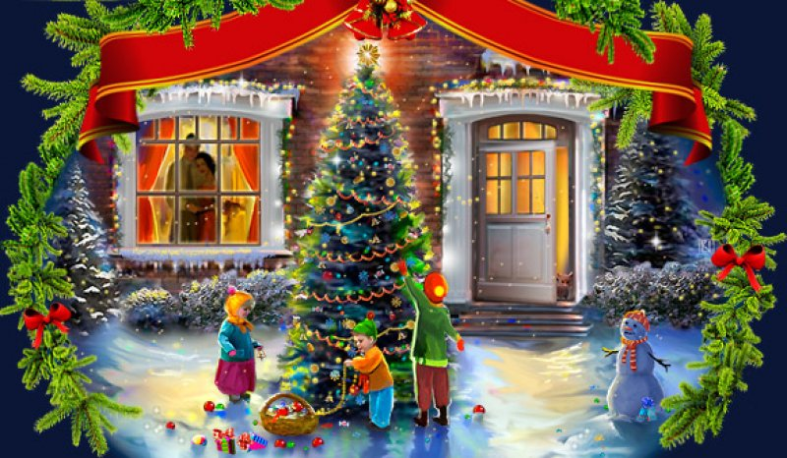
New Year
New Year’s Eve all British celebrate on the 31st of December. Most people see with friends and relatives.
At midnight they sings New Year songs and wishes a happy New Year.

Slide 5
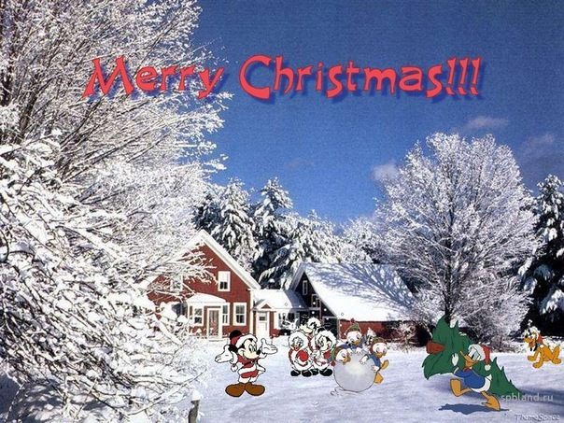
Christmas
On the 25th of December there is the greatest holiday of all in England – Christmas. People send X-mas cards to their friends and relatives. People buy a Christmas tree and decorate it with toys, balls and lights.
Children wake up early to find stockings full of small presents on their bed.

Slide 6
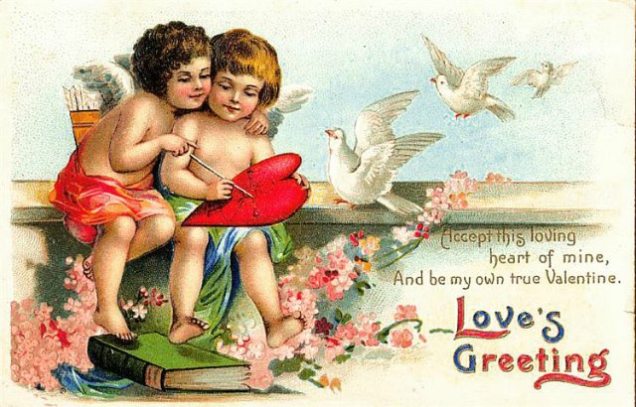
St. Valentine’s day
On the 14th of February there is St. Valentine’s Day. People send Valentine’s cards to someone they love. Usually they don’t sing them – you must guess who sent cards to you.

Slide 7
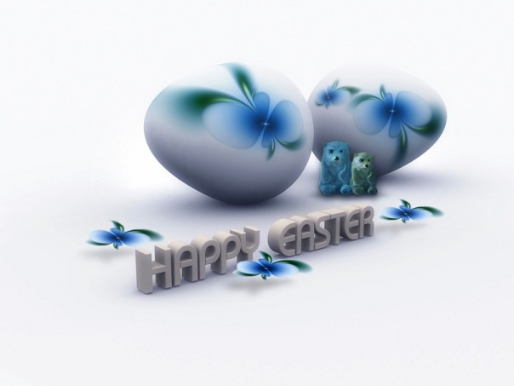
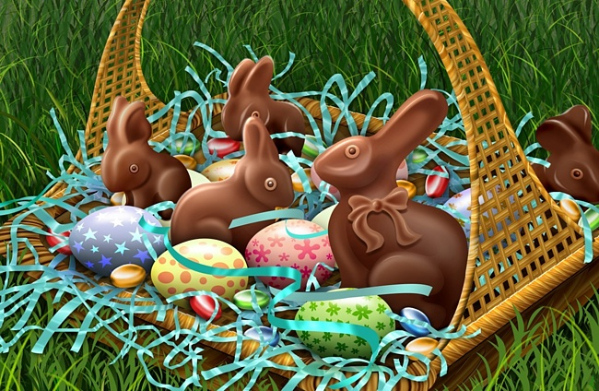
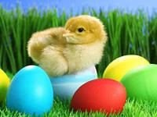
Easter
In April or at the end of March English people celebrate Easter Day.
On Easter Sunday children get chocolate eggs and rabbits.

Slide 8
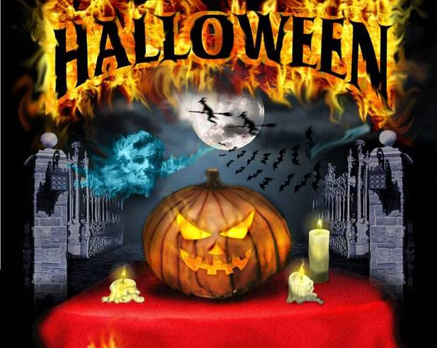
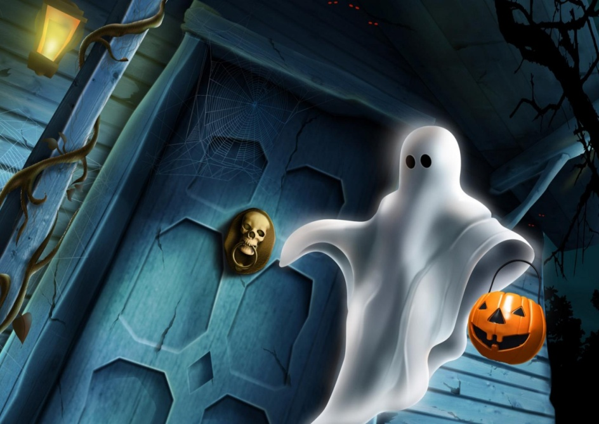
Halloween
On the 31st of October there is Haloweeen. The symbol of this holiday is "Jack o'lantern“
People make it from a pumpkin.
Children like Haloween parties, they put on witch’s and ghost’s dresses. They go “trick or treat”.

Slide 9
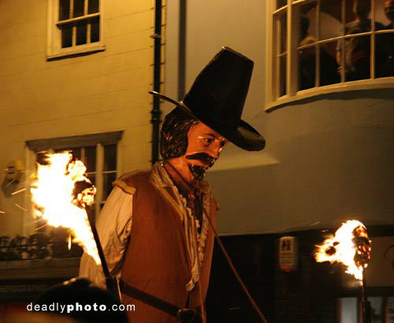
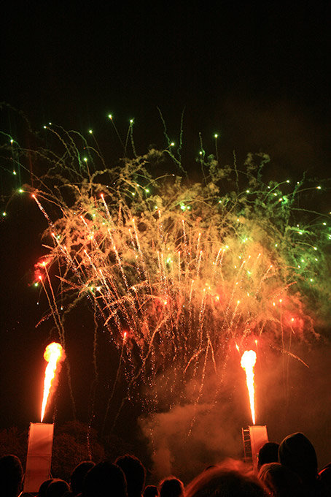
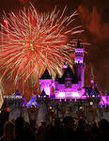
Guy Fawkes’ Night is on 5 November. People
make bonfires and gather near them.

